Slide 1

Cryptography
CS-486
November 13th, 2017 r00 Paul A. Lambert

Slide 2
Cryptography MondayNovember 13th, 2017
ECIES:
Quiz
Please read: PoC||GTFO 5:3 ”ECB: Electronic Coloring Book” 6:7 “More Cryptographic Coloring Books”
Key Exchanges
Email security:
homepages.gold.ac.uk/rachel/CIS326week9.ppt
www.cse.scu.edu/~tschwarz/COEN350_09/PPtPre/EmailSecurity.ppt

Slide 3
ECIES
Use public/private key pairs to encrypt information to public key(s). Use ECIES to encrypt the information. For example, Figure 2 in: A Survey of the Elliptic Curve Integrated Encryption Scheme
Elliptic curve routines are available: https://github.com/CryptoUSF/Wallet/tree/master/src/ecc
AEAD encryption algorithms are available on Github:
AES-SIV https://github.com/CryptoUSF/Wallet/tree/master/src/cipher
ChaCha_Poly_AEAD https://github.com/CryptoUSF/Wallet/blob/master/src/cipher/chacha_poly.py
Document your choices for each algorithm block (e.g. KDF). The ECIES routines should be structured as a reusable library. The user interaction may be through a command-line interface. The software should be in a github repository with a readme.md file providing a brief description.
Bonus points awarded for:
documentation of requirements or use case
good documentation
fully 'packaged' software
well written code
designs with good human usability

Slide 4
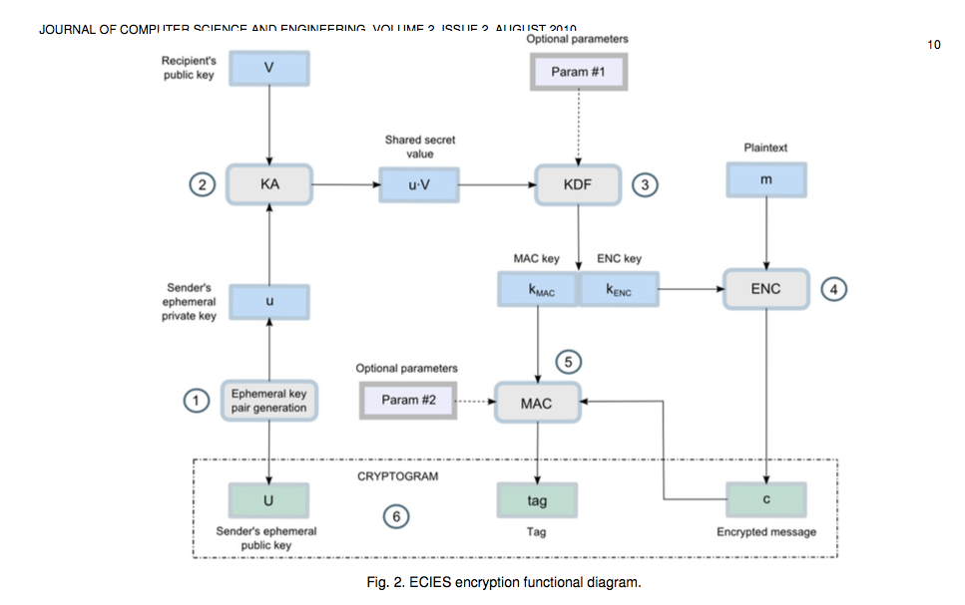
ECIES
https://www.researchgate.net/publication/255970113_A_Survey_of_the_Elliptic_Curve_Integrated_Encryption_Scheme

Slide 5
ECIES
AEAD
https://www.researchgate.net/publication/255970113_A_Survey_of_the_Elliptic_Curve_Integrated_Encryption_Scheme

Slide 6
ECIES with an AEAD
V (Peer Public Key)
Additional Data
Plain Text / Data
ad
pt
AEAD
(e.g. ChaCha_AEAD)
key=KDF(u*V)
key
u = new private key
U = u*G
IV/nonce
U
IV
Cipher Text
Tag

Slide 7
ECIES with SIV
V (Peer Public Key)
Additional Data
Plain Text / Data
pt
ad
SIV AEAD
(e.g. AES-SIV
key=KDF(u*V)
key
u = new private key
U = u*G
U
SIV
Cipher Text

Slide 8
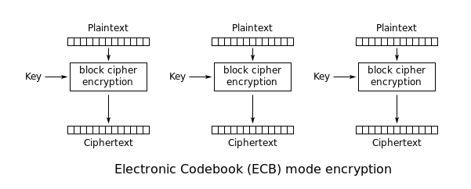
ECB Mode
https://en.wikipedia.org/wiki/Block_cipher_mode_of_operation

Slide 9
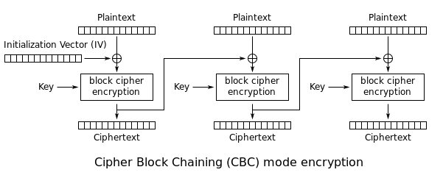
CBC Mode
https://en.wikipedia.org/wiki/Block_cipher_mode_of_operation

Slide 10
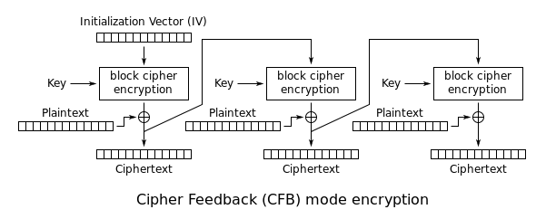
CFB Mode
https://en.wikipedia.org/wiki/Block_cipher_mode_of_operation

Slide 11
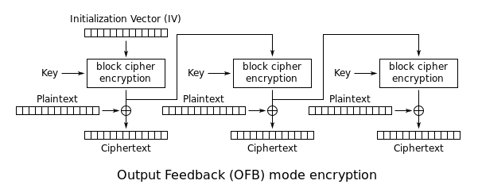
OFB Mode
https://en.wikipedia.org/wiki/Block_cipher_mode_of_operation

Slide 12
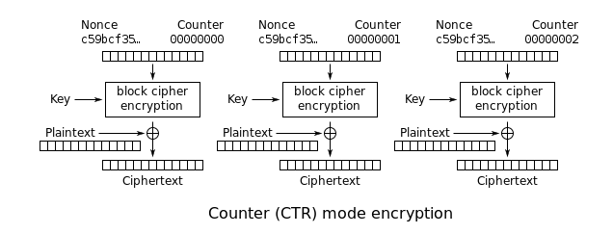
CTR Mode
https://en.wikipedia.org/wiki/Block_cipher_mode_of_operation

Slide 13
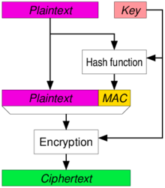
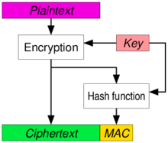
Authenticated Encryption
https://en.wikipedia.org/wiki/Authenticated_encryption

Slide 14
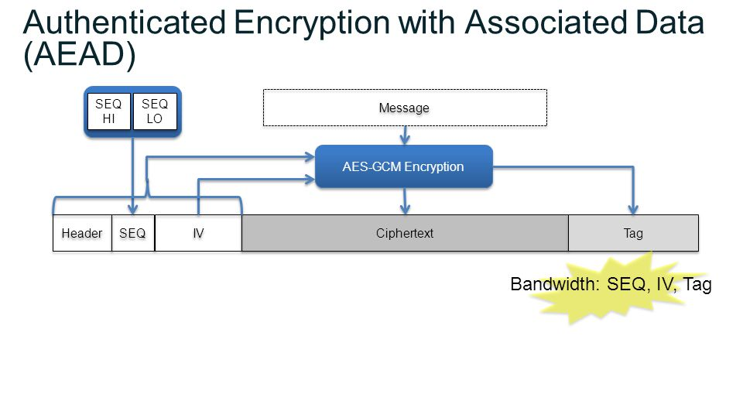
AES-GCM (an AEAD)

Slide 15
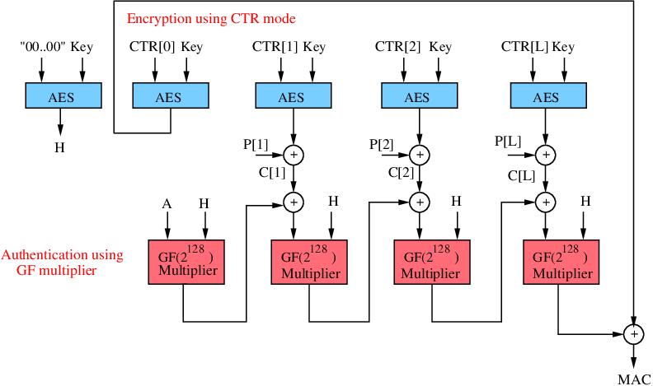
AES-GCM (an AEAD)

Slide 16
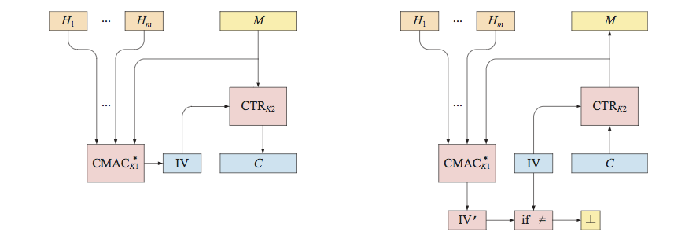
SIV Mode
http://web.cs.ucdavis.edu/~rogaway/papers/siv.pdf
https://tools.ietf.org/html/rfc5297

Slide 17
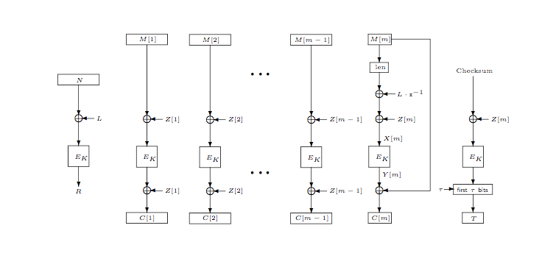
OCB
http://web.cs.ucdavis.edu/~rogaway/papers/ocb-full.pdf

Slide 18
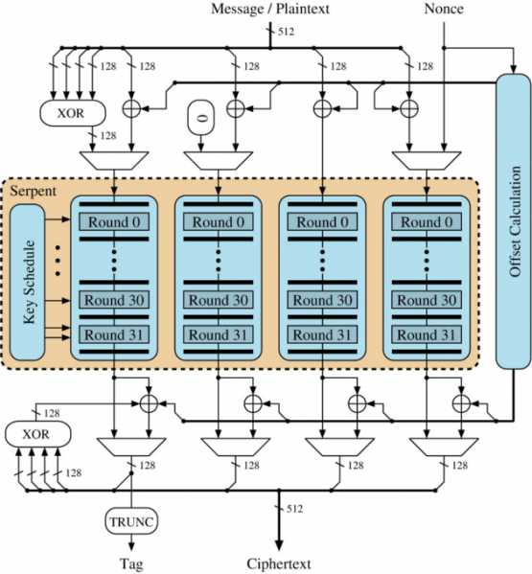
OCB Again

Slide 19
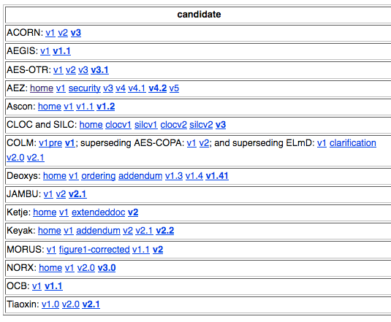
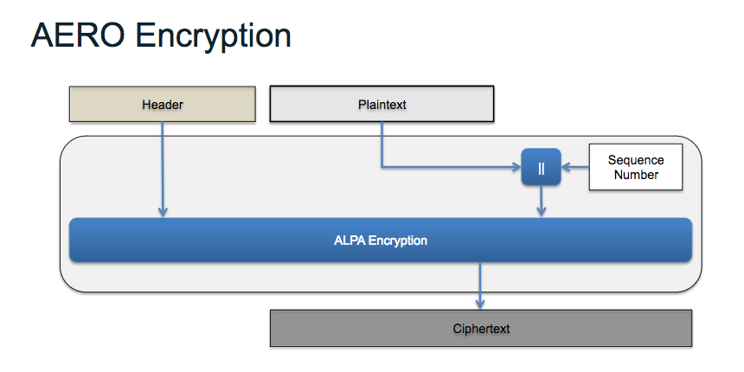
Other AEAD Algorithms
Caesar competition (2018): https://competitions.cr.yp.to/caesar-submissions.html
https://csrc.nist.gov/csrc/media/events/lightweight-cryptography-workshop-2015/documents/presentations/session8-mcgrew.pdf

Slide 20
Email, PEM, PGP
www.cse.scu.edu/~tschwarz/COEN350_09/PPtPre/EmailSecurity.ppt

Slide 21
Backup Material

Slide 22
Logistics for Class
Canvas CS-486-01
Primary repository for grading
URL for all homework submittals must be ‘linked’ into the appropriate Canvas assignment!
Github: https://github.com/CryptoUSF
Course material, class presentations, references, books
Sample code for assignments: https://github.com/CryptoUSF
Private student repositories,
too many if one per assignment per student
Wiki for additional class information and assignements
Piazza: CS486
Informal class conversations

Slide 23
Additional References
Courses:
https://crypto.stanford.edu/~dabo/courses/OnlineCrypto/
http://cseweb.ucsd.edu/~mihir/cse207/
Conferences:
Real World Cryptography
https://www.iacr.org
Mailing Lists and Standards:
http://csrc.nist.gov US Federal security specifications
https://trac.ietf.org/trac/sec/wiki Internet security standards
https://irtf.org/cfrg Internet cryptographic research

Slide 24
Raspberry Pi
We will use a Raspberry Pi to get experience using contemporary analysis ‘tools’
Raspberry Pi
Excellent reference for what to acquire and how to setup:http://rpi.cs.usfca.edu/2017-fall
The first Pi project will use cryptographic related tools that are available in the Kali distribution: https://www.kali.org/
The tools do not necessarily require the Kali OS distribution and you may be able to simply install some of the tools on an existing Raspberry Pi OS installation.

Slide 25
TLS Packet Capture
Install and run ‘wireshark’
May require ‘sudo’
Set filter for ‘ssl’
Open browser and connect to a HTTPS web page
Examine packets captured for TLS packet exchange
Identify cipher suites from client
Identify server certificates
Identify algorithms used by server

